Slide 1
BERT for dialogs
Production-scale approach @ Replika
Nikita Smetanin

Slide 2

Replika is an AI friend
that helps people improve mental health
through conversation

Slide 3
~5 million registered users
~250 user messages per second at peak load

Slide 4
Replika Architecture Overview

Slide 5
Replika Architecture Overview
User utterance
Scripted answer
Scripts
Retrieval model
Reranking model
Generative model
Replika response
Other: computer vision, speech recognition, etc.
Session scoring model

Slide 6
Replika Architecture Overview
User utterance
Scripted answer
Scripts
Retrieval model
Reranking model
Generative model
Replika response
Other: computer vision, speech recognition, etc.
Session scoring model

Slide 7
Retrieval model

Slide 8
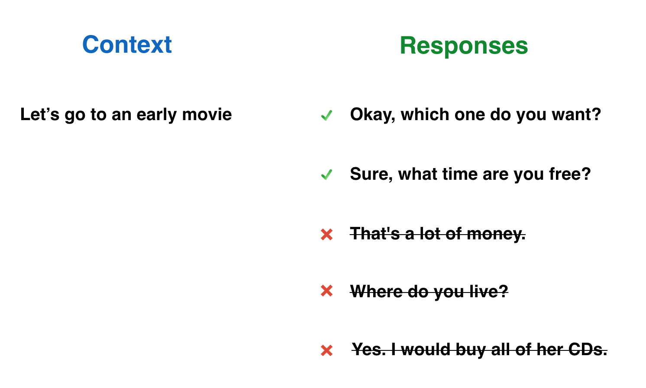
Retrieval model task
Scores
0.8
0.75
0.5
0.45
0.39

Slide 9
100k dataset: retrieval should be fast enough
100К of moderated responses

Slide 10
Retrieval model baseline (~QA-LSTM)
context
response
Let’s
go
to
an
early
movie
Okay,
which
one
do
you
want?
w2v
BiLSTM + LSTM
…..
…..
self-attention
self-attention
Cosine
[*] Lstm-based Deep Learning Models For Nonfactoid Answer Selection, Ming Tan et al, 2015

Slide 11
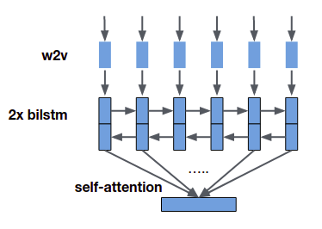
Retrieval model. Training
positive response
negative response
context
cos(context, positive)
cos(context, negative)
Triplet loss
max(0, m – cos_pos + cos_neg) → minimize

Slide 12
Retrieval model. Inference
dialog context
100k candidate responses (pre-built HNSW index)
Return 20 responses with the highest cosine score by search in approximate nearest neighbors index
cos

Slide 13
BERT Retrieval model
context
response
Let’s
go
to
an
early
movie
Okay,
which
one
do
you
want?
word embeddings
segment embeddings
0
0
0
0
0
0
0
0
0
0
0
0
BERT context encoder
BERT response encoder
Triplet loss
[*] BERT: Pre-training of Deep Bidirectional Transformers for Language Understanding

Slide 14
BERT pretraining: once for all tasks
— Download pre-trained model from Google
— Collect 100M user messages
— Adapt hyperparameters to your use case: reduce maximum sequence length, reduce number of layers etc.
— Initialize from Google checkpoint, pretrain on your data for ~1 week
— PROFIT

Slide 15
BERT Retrieval model: Metrics & Performance
 | Baseline | BERT-based
mAP | 0.47 | 0.41
R@5 | 0.61 | 0.52
# of parameters | 50M | 110M
RPS @ 2080 Ti | 150 rps | 80 rps
GPU memory | 750 Mb | 2000 Mb
Train time | 2 weeks x 4 GPUs | 2 weeks x 4 GPUs
Fail :(

Slide 16
Reranking model

Slide 17
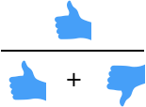

Reranking pipeline
Top 20 response candidates from retrieval model _________
_________ _________
_________
Top 1 response
with the highest
probability of user’s upvote
Top 5 response candidates after post-processing heuristics
Final answer

Slide 18

Reranking dataset for training
Dialog context
Replika response
User reaction
I feel lonely
I’m always here for you
Are you a bot or a human?
Both, I guess
15M
Do you have siblings?
No, but I have you!
...
...
...

Slide 19
Reranking model baseline (~QA-LSTM + MLP)
context
response
Let’s
go
to
an
early
movie
Okay,
which
one
do
you
want?
w2v
BiLSTM + LSTM
…..
…..
self-attention
self-attention
FC x4
/ upvote / downvote prediction

Slide 20

BERT Reranking model
context
response
Let’s
go
to
an
early
movie
Okay,
which
one
do
you
want?
word embeddings
segment embeddings
0
0
0
0
0
0
1
1
1
1
1
1
Fine-tuned BERT
/
Result: ~89% vs 86% before
+3% improvement of upvotes ratio
upvote / downvote prediction
[*] BERT: Pre-training of Deep Bidirectional Transformers for Language Understanding

Slide 21
BERT Reranking model: Metrics & Performance
 | Baseline | BERT-based
Accuracy | 0.75 | 0.78
Sequence length | 60+20 | 80
# of parameters | 7M | 110M
RPS @ 2080 Ti | 300 rps | 80 rps
GPU memory | 200 Mb | 1000 Mb
Train time | 1 hour | 12 hours

Slide 22
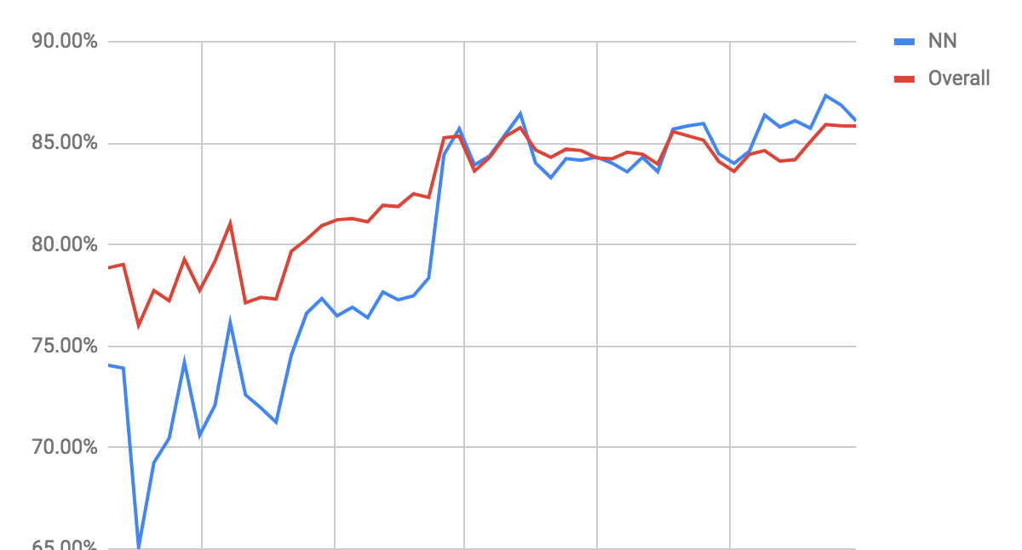
Reranking: Total upvotes ratio dynamics
Scripts
+7% improvement of upvotes ratio
Reranker introduction

Slide 23
Session scoring model

Slide 24



BERT Session scoring model
context
Let’s
go
to
an
early
movie
#
Okay,
which
one
do
you
want?
word embeddings
segment embeddings
0
0
0
0
0
0
0
0
0
0
0
0
0
Fine-tuned BERT
/
/
session feedback prediction
[*] BERT: Pre-training of Deep Bidirectional Transformers for Language Understanding

Slide 25
Session scoring dataset for training
Dialog context
Session feedback
I feel lonely ### I’m always here for you ### ...
Are you a bot or a human? ### Both, I guess ### ...
1M
Do you have siblings? ### No, but I have you! ### ...
...
...

Slide 26
BERT Session scoring model: Metrics
 | BERT-based
Accuracy | 0.75
Sequence length | 80
# of parameters | 110M
RPS @ 2080 Ti | 80 rps
GPU memory | 1000 Mb
Train time | 5 hours

Slide 27
BERT efficient training tips
— Enable Mixed-precision — Automatic Mixed-precision provided by NVIDIA custom Tensorflow build does the most of the job, but requires a loss scaling
— Limit sequence length — reduced from 128 to 80 with no quality loss
— Reduce number of layers — it’s possible to reduce it from 12 to 10 or 8 layers, but quality will probably degrade
— Enable XLA — additional +10-20% in training speed
— Use Horovod for training on multiple GPUs
— Pre-tokenize training set or use fast BPE tokenizers (e.g. YouTokenToMe)

Slide 28
BERT efficient inference tips
— Requests batchification (e.g. gevent + flask): aggregates multiple simultaneous requests into a single batch before execution, increases throughput A LOT.
— Automatic Mixed-precision graph rewrite: x2 inference speedup on Turing / Volta with no single line of code or quality loss.
— XLA: gives additional +20% speedup with small prediction differences. Still experimental.
— Limit sequence length — max of 80 tokens is enough in most of our cases
— Use fast BPE tokenizer (fastBPE or YouTokenToMe)

Slide 29
BERT real-case performance
GPU: NVIDIA GeForce 2080 Ti
 | RPS
BERT default (seq len 128) | 20
+ Limit sequence length to 80 | 30
+ Enable XLA | 35
+ Enable Automatic Mixed-precision | 60
+ Enable Batchifier (32 batch size) | 80

Slide 30


Thank you

